Slide 1
Digital Portfolio
STUDENT NAME: KAVIYA S
REGISTER NO AND NMID: 2428C0481 & D9AE028A4ADA51B85A745035963DCFA3
DEPARTMENT: B.Sc - AIML
COLLEGE: KPR COLLEGE/ BHARATHIYAR UNIVERSITY

Slide 2
PROJECT TITLE
Personal Doctor’s Portfolio Website.

Slide 3


AGENDA
Problem Statement
Project Overview
End Users
Tools and Technologies
Portfolio design and Layout
Features and Functionality
Results and Screenshots
Conclusion
Github Link
3/21/2024 Annual Review

Slide 4

PROBLEM STATEMENT
Many doctors lack a dedicated digital portfolio to showcase their expertise, achievements, and contributions to the medical field in a clear and accessible way. Relying only on a traditional CV or hospital profile often fails to highlight their specializations, case studies, research work, and career milestones effectively. In today’s healthcare environment, where trust, visibility, and professional networking are important, a well-designed portfolio can help doctors present their skills, build credibility, connect with peers and institutions, and attract opportunities for collaboration and growth.

Slide 5

PROJECT OVERVIEW
About Me: A brief introduction, medical background, and area of specialization Medical Skills & Expertise: Key abilities, diagnostic strengths, surgical or clinical specialties Experience & Achievements: Hospitals served, notable cases, research papers, and awards Publications & Conferences: Articles, journals, and medical events attended or presented Contact & Appointments: How patients, peers, or institutions can reach or collaborate

Slide 6

WHO ARE THE END USERS?
Doctors showcasing their expertise, achievements, and career journey
Hospitals & Clinics reviewing profiles for recruitment or collaboration
Patients seeking trusted, qualified specialists for consultations
Medical Institutions evaluating credentials for academic or research roles
Healthcare Organizations exploring partnerships, conferences, or speaking opportunities

Slide 7

TOOLS AND TECHNIQUES
HTML CSS JavaScript GitHub VS Code

Slide 8
POTFOLIO DESIGN AND LAYOUT
Home / About Doctor – Quick introduction, medical background, and specialization Experience & Services – Work history, treatments offered, and areas of expertise Skills & Certifications – Key medical skills, certifications, and qualifications Research & Publications – Journals, case studies, and conference presentations Contact / Appointment – Easy way for patients, peers, or institutions to get in touch Responsive Layout – Optimized for viewing on desktop, tablet, and mobile devices
8

Slide 9
FEATURES AND FUNCTIONALITY
Intuitive Navigation – Smooth scrolling to sections like About, Specializations, Experience, and Contact. Professional Profile Showcase – Highlight qualifications, certifications, and achievements with visual emphasis. Patient & Peer Interaction – Sections for testimonials, case studies, or professional contributions. Contact & Appointment Form – Easy-to-use form for patients or colleagues to reach out or request appointments. Responsive Design – Optimized for desktop, tablet, and mobile devices to ensure accessibility. Interactive Health Portfolio – Optionally include media like procedure photos, health seminars, or research publications.

Slide 10
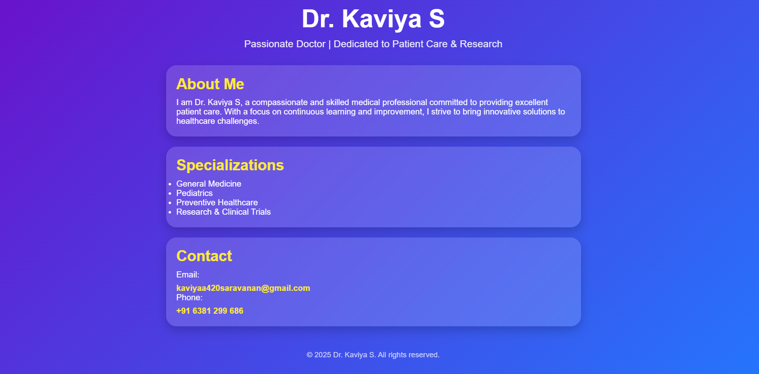

RESULTS AND SCREENSHOTS
3/21/2024 Annual Review
10

Slide 11
GITHUB LINK
https://github.com/kaviyaa420saravanan
11

Slide 12
CONCLUSION
Highlights my medical expertise, specializations, and key professional accomplishments. Summarizes my clinical experience, certifications, and contributions to healthcare. Helps patients, peers, and institutions understand my professional capabilities. Facilitates connections with patients, medical collaborators, and healthcare organizations. Builds a trusted and professional online presence in the medical field.
12

